Slide 1
COS226- Concurrent Systems
Lecture 1- Introduction
Thambo Nyathi (t.nyathi@up.ac.za)

Slide 2
Introduction
Program functionality is normally a sequential iterative process.
Thus programs are normally designed to function one step at a time i.e one instruction at a time.
Operating systems were originally developed to allow only one program to run at a time.
OS with time have evolved to permit more than one program to run at a time in processes.
This is motivated by , resource utilization, fairness and convenience.

Slide 3
Resource utilization – a program may require an external input so instead of the processor lying idle another program makes use of the processor therefore improving efficiency.
Fairness-multiple processes may have equal share to the available resources therefore time slicing could be used.
Convenience – It is desirable to develop multiple programs that each perform a single task and have them to coordinate than to write a big program that performs all the tasks.

Slide 4
In early systems , each process was a virtual von Neuman computer i.e with memory that had instructions and data.
Execution of instructions was sequential.
For each instruction executed there is a next instruction.
Most programming languages follow this sequential programming model, where it is clearly defined what comes next after a given action.
The assumption is that the processes involved are synchronous, which is not always the case.

Slide 5
Finding the right balance between sequentiality and asynchrony is often a challenge.
Asynchrony is when a process has a task that another process does not depend on thus it can occur independently.
The same concerns that motivated the development of processes i.e resource utilization, fairness and convenience also motivated threads.

Slide 6
Threads
Threads allow multiple streams of program control flow to coexist within a process.
Threads share process wide resources eg memory, and file handles but each thread has its own program counter, stack and local variables.
Multiple threads within the same program can be scheduled simultaneously on multiple CPUs.
Threads are considered as lightweight processes.
In the absence of explicit coordination threads , execute simultaneously and asynchronously with respect to each other.

Slide 7
Threads
Since threads share the same memory of their owning processes all threads within a process have access to the same variables and allocate objects from the same heap.
However, without explicit synchronization to coordinate access to shared data, a thread may modify variables that another thread is currently using resulting in unpredictable results.

Slide 8
Why Thread
We separate multiple tasks which may be time critical and can execute independently. For example downloading a file while listening to music at the same time uses different threads.
Multithreading is the ability of a CPU to execute multiple processes or threads concurrently.
Both processes and threads are independent sequences of execution.
A process is an instance of program execution.

Slide 9
Process
Opening an application such as a web browser or email client starts a distinct process. The OS does the following:
assign a distinct register for each process
opens a program counter for each process
assigns stack memory
assigns heap memory

Slide 10
A Thread
As mentioned a thread is a light weight process.
it is a unit of execution within a process.
a process may have several threads.
each thread in the process shares memory and resources.
creating a new thread requires less resources than creating a new process.

Slide 11
Process vs Threads
A process runs independently and isolated of other processes. It cannot directly access data in other processes. (OS controlled)
A thread has its own call stack, but can access shared data of other threads in the same process.
Every thread has its own memory cache. If a thread reads shared data, it stores this data in its own memory cache.
A thread can re-read the shared data.

Slide 12
Advantages of Threads
Threads can reduce development and maintenance costs and improve the performance of complex applications.
On a 2 processor system a single threaded program is giving up access to half the available resources. On a 100 processor system it gives up access to 99%. However a multi-threaded program can have multiple threads efficiently using the multiprocessor system.
Using multiple threads can achieve better throughput on single-processor systems. Another thread can make use of the processor while the first thread is waiting for a synchronous I/O operation to complete.

Slide 13
Advantages of Threads
A complicated asynchronous work flow can be decomposed into a number of simpler, synchronous work flows each running a separate thread interacting at specific synchronization points.

Slide 14
Disadvantages of Threads
Thread safety- In the absence of sufficient synchronization unpredictable results may be yielded.
Liveness failure – an example of this in a sequential program is an infinite loop. In threads Thread A might depend on a resource held by Thread B and if B does not let go of the resource A waits forever.
Concurrent applications carry a runtime overhead. For example context switching i.e when the scheduler switches temporarily between threads. Additionally the CPU can spend time scheduling threads instead of running them.

Slide 15
Disadvantages of Threads
Threads have their own call stacks, but can also access shared data. Therefore you have two basic problems, visibility and access problems.
A visibility problem occurs if thread A reads shared data which is later changed by thread B and thread A is unaware of this change.
An access problem occurs if several threads access and change the same shared data at the same time.

Slide 16
Time Slicing
This is when a single CPU is running K-Threads and has to share thread execution among the threads. For example if we have thread#1 and thread#2. Thread#1 runs for a certain period of time and then thread#2 runs.

Slide 17
Concurrency in Java
Java is a multithreaded programming language which means we can program multithreaded programs using Java.
A multithreaded program contains two or more parts that can run concurrently and each part can handle a different task at the same time making optimal use of the available resources more so when the computer has multiple CPUs.
By definition, multitasking is when multiple processes share common processing resources such as a CPU.
Multithreading extends the idea of multitasking into applications where you can subdivide specific operations within a single application into individual threads. The threads can run in parallel

Slide 18
The OS divides processing time not only among the applications but also among each thread within an application.
Multithreading enables you to write programs in a way where multiple activities can proceed concurrently in the same program.

Slide 19
Thread States
New – when a thread is instantiated, it is in this state until it is started by the start method.
Runnable- when the thread is started.
Running - after the thread has been started and it is executing its task.
Waiting – when a thread is waiting for another thread to finish its task. When other thread signals then this thread goes back to the runnable state.
Dead (terminated)- after it has finished its task.

Slide 20
Common Methods
start() – Starts the thread.
getState() – It returns the state of the thread.
getName() – It returns the name of the thread.
getPriority() – It returns the priority of the thread.
sleep() – Stop the thread for the specified time.
Join() – Stop the current thread until the called thread gets terminated.
isAlive() – Check if the thread is alive.

Slide 21
Creating a Thread
There are two ways to create a thread:
By extending the Thread class.
By implementing the Runnable interface.

Slide 22
Extending a Thread Class
This approach provides more flexibility in handling multiple threads created using available methods in the Thread class.
Step 1
You will need to override the run() method available in the Thread class. This method provides an entry point for the thread and the complete business logic is placed in this method.
public void run()
Step 2
Once the Thread object is created, you can start it by calling the start()
method, which calls run() .
void start()

Slide 23
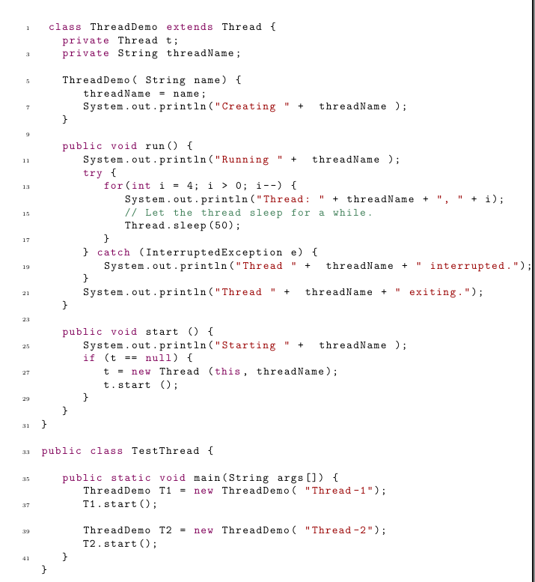

Slide 24
Implementing the Runnable Interface
Step 1
Implement a run() method for the runnable interface to perform your task.
Step 2
Instantiate a thread object using the following constructor
Thread(Runnable threadObj, String threadName) where threadObj is an instance of a class that implements the Runnable interface and threadName is the name of the thread

Slide 25
Step 3
Once a Thread object is created, you can start it by calling the start() method, which executes a call to the run() method.

Slide 26
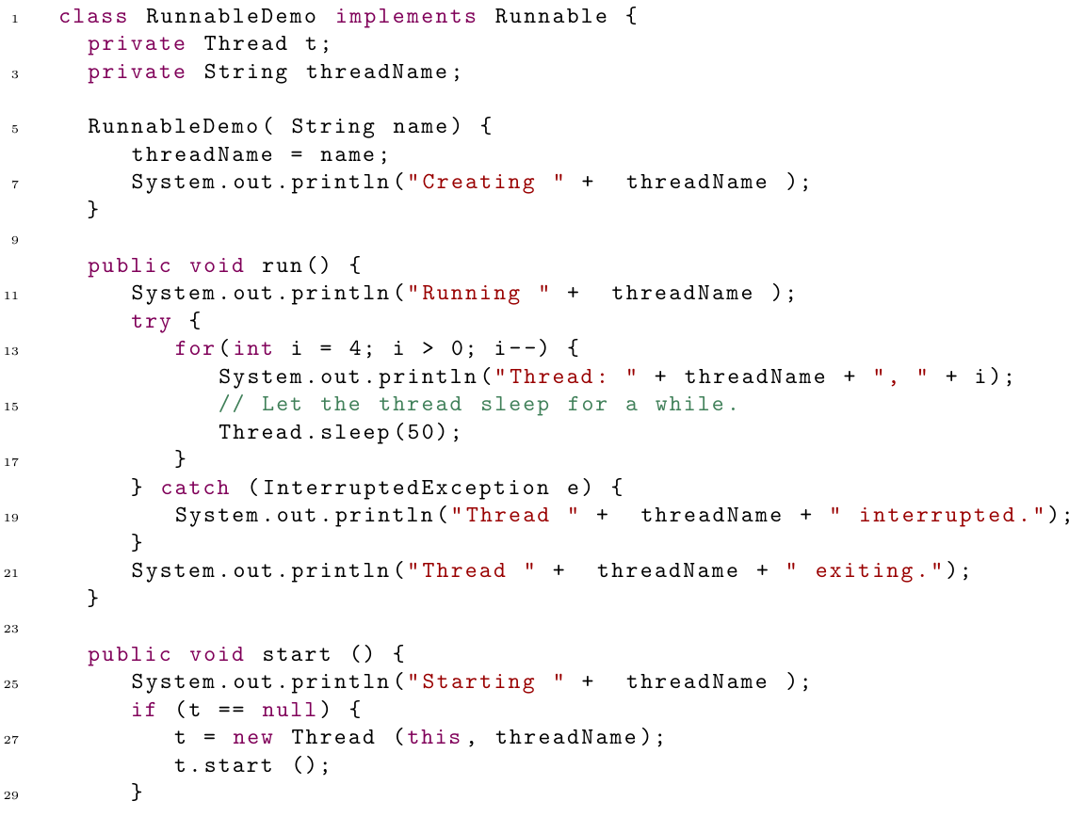

Slide 27
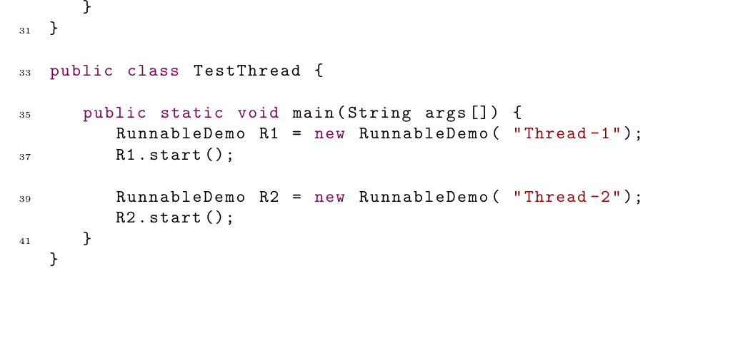

Slide 28
Task 1- Tutorial
Review the following in Java.
Interfaces specifically , Runnable and Callable
Program the demo programs presented in todays lecture.

